Slide 1
EVENT MANAGEMENT SYSTEM
GUIDED BY
Dr.V.Nivedita,M.E,Ph.D.
Assistant Professor
BATCH MEMBERS
Ramanan.E (812419104052)
Tony Christopher.J (812419104071)
Nirmal Kumar.M (812419104701)

Slide 2
OBJECTIVE
System very efficiently store, maintain and retrieve data from its database and can be used for further analysis. This system provides latest notification to its user .
Time saving activity. The data in a centralized way which is available to all the event managers.Easy to manage historical data in database.
Participants can register for any happening event from anywhere. Event manager can keep records of participants.

Slide 3
INTRODUCTION
Event management system is used to manage all the activity related to event. In any event many service providers work simultaneously and it is very hard to manage these providers. It is also important for event organizer that he has all the contacts details of these service providers so that he can contact them any time to plan an event at given time. To manage all these activity we have developed this software. To get success in the event management business, user should have strong network contacts of service provider.

Slide 4
SOFTWARE AND HARDWARE REQUIREMENTS
HARDWARE REQUIREMENTS
Processor : Any Processor above 500 MHz
RAM : 512MB
Hard disk : 40 GB
Compact Disk : 650 MB
SOFTWARE REQUIREMENTS
Operating system : Windows
Front End : HTML, CSS, JavaScript
Database : MySQL Server

Slide 5
PROJECT DESCRIPTION
Event management is the oversight of many administrative details for events such as conferences, festivals, or weddings.
An event manager works with staff and vendors to make sure the event is executed according to plan.
While event planners tend to work on the overall event concept, event managers deal with the details of its execution.

Slide 6
MODULES
Home page
Events page
About page
Volunteer page
Contact us page

Slide 7
MODULES DESCRIPTION
HOME PAGE
The first pages of information on the Internet that belongs to a person or an organization.
A home page contains connections to other pages of information

Slide 8
MODULE DESCRIPTION
EVENTS PAGE
An event page is a unique, stand-alone web page that can be automatically created for any event on your Team up calendar.
When you create an event page from the sharing options a resulting web page will open up in a new browser tab. This is the event page.

Slide 9
MODULE DESCRIPTION
ABOUT PAGE
The about us page is often a reflection of the purpose and personality of the business and its owners or top employees.
Finally, the page can also incorporate contact or location information. One way to view the about us concept is as a text self-portrait or short autobiography created by a business.

Slide 10
MODULE DESCRIPTION
VOLUNTEER PAGE
Gives something back to an organization that has impacted on a person's life, either directly or indirectly.
Make a difference to the lives of others. helps the environment, helps others less fortunate or without a voice.

Slide 11
MODULE DESCRIPTION
CONTACT US PAGE
Ideally, a contact page should include both an email address and a contact form for visitors to fill out.
You may also choose to include a business address, phone number, or specific employee/department contact information.

Slide 12
CONCLUSION
Event Management System is user friendly and cost effective system, it is customized with activities related to event management life-cycle.
It provides a new edge to management industry.

Slide 13
FUTURE ENHANCEMENT
The project has a very vast scope in future.
The project can be implemented on intranet in future.
Project can be updated in near future as and when requirement for the same arises, as it is very flexible in terms of expansion.
With the proposed software of database Space Manager ready and fully functional the client is now able to manage and hence run the entire work in a much better, accurate and error free manner.

Slide 14
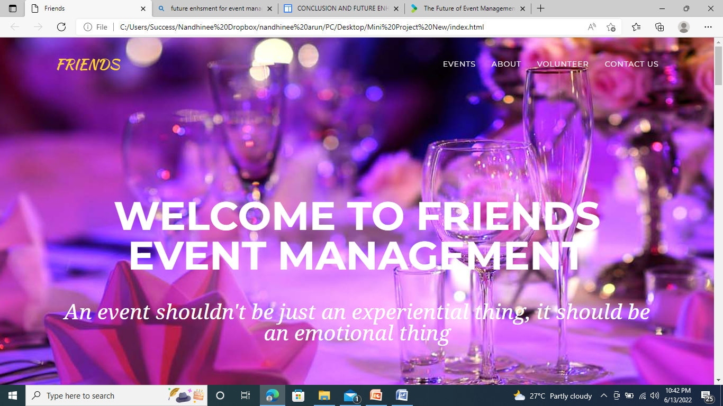
SCREENSHOTS
Figure 1 Homepage Interface

Slide 15
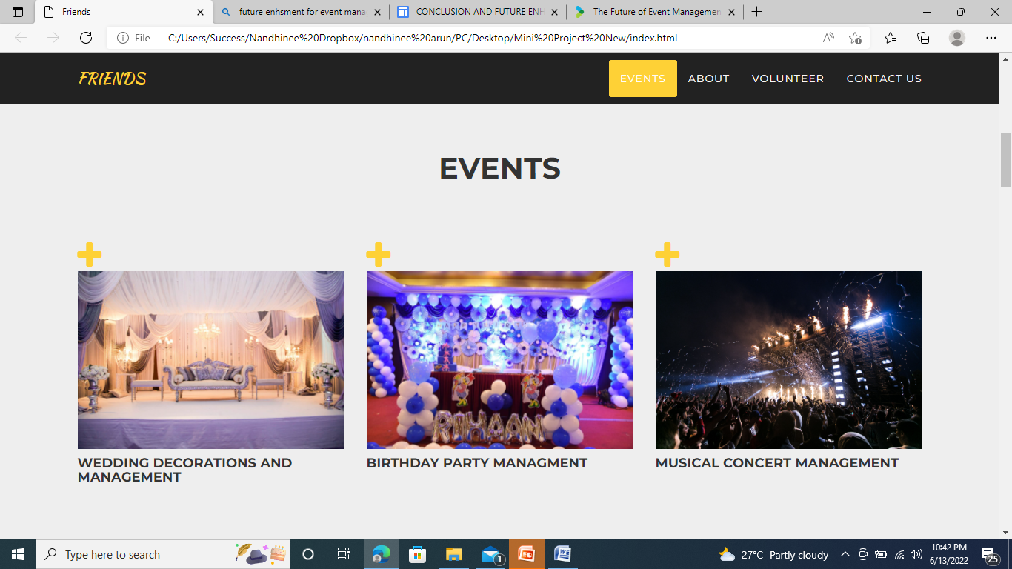
SCREENSHOTS
Figure 2 Events Interface

Slide 16
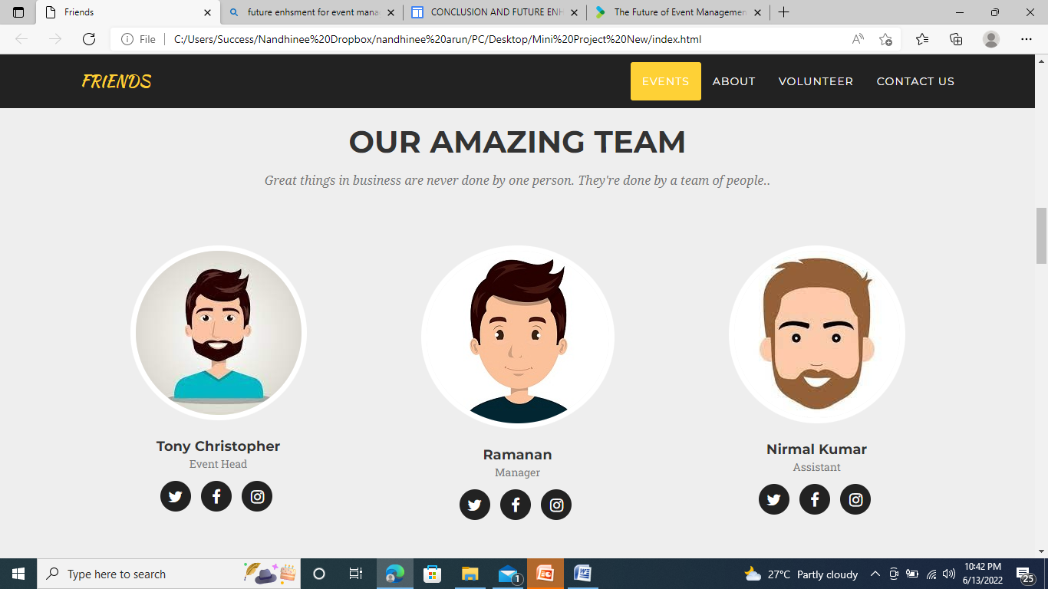
SCREENSHOTS
Figure 3 About Interface

Slide 17
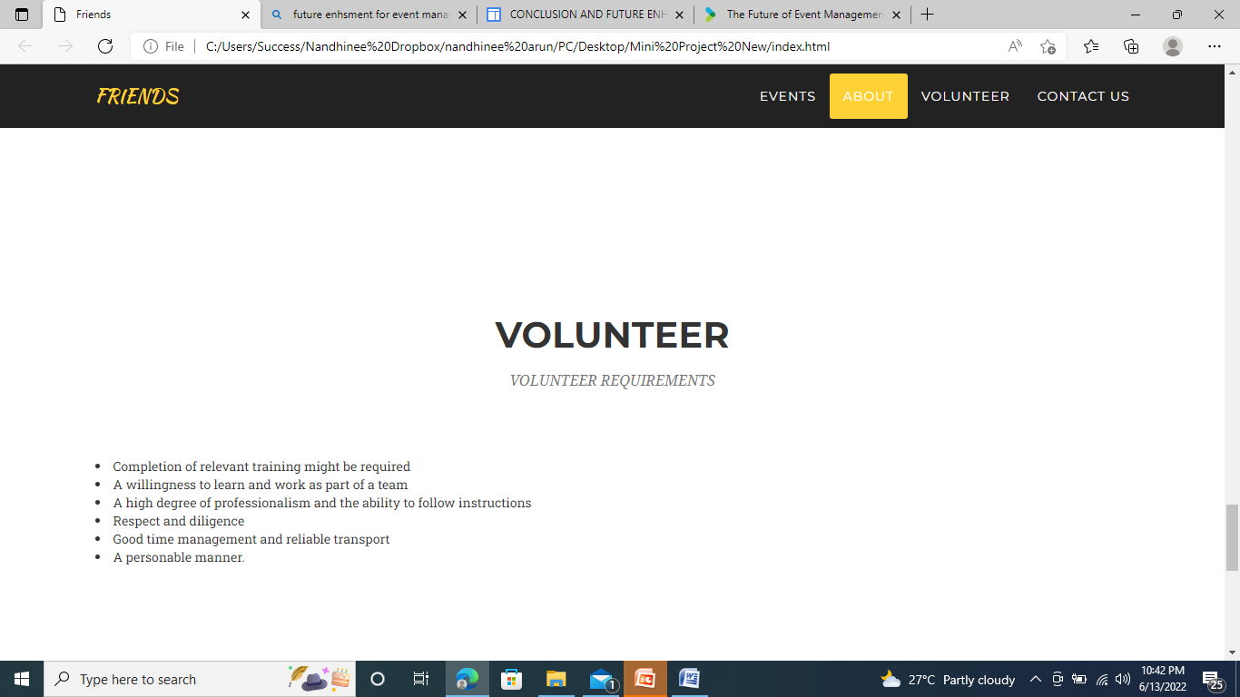
SCREENSHOTS
Figure 4 Volunteer Interface

Slide 18
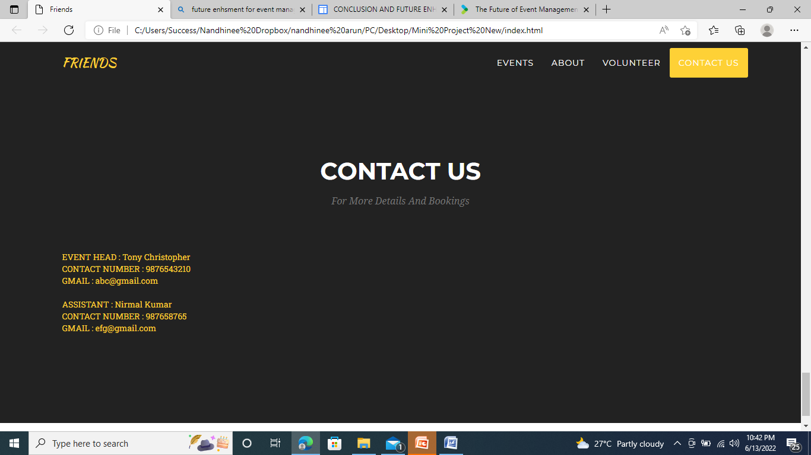
SCREENSHOTS
Figure 5 Contact Us Interface

Slide 19
REFERENCES
Becker, J. & Schütte, R. (2004). Handelsinformationssysteme : Domänenorientierte einführung in die wirtschaftsinformatik (2nd ed.) Landsberg/Lech: Moderne Industrie.
Clarke, A. (2004). Evaluating mega-Events : A critical review. Paper ppresented at the 3rd DeHaan Tourism Management Conference “The Impact and Management of Tourism-Related Events”. University of Nottingham: UK
Curran, T. A., Keller, G., & Ladd, A. (1998). SAP R/3 business blueprint:Understanding the business process reference model. Upper Saddle River, NJ: Prentice Hall PTR.
Drengner, J. (2003). Imagewirkungen von eventmarketin : Entwicklung eines ganzheitlichen Messansatzes. Wiesbaden: DUV.
Erber, S. (2002). Eventmarketing: Erlebnisstrategien für Marken; Innovative Konzepte, zahlreiche Fallbeispiele, viele Tipps zur Umsetzung in der Praxis (3rd ed.) Munich: Redline Wirtschaft bei Verl. Moderne Industrie.
Fettke, P. & Loos, P. (2003). Classification of reference models - A methodology and its application. Information Systems and e-Business Management, 1(1), 35-53.
Fettke, P., Loos, P., & Zwicker, J. (2006). Business process reference models: Survey and classification. In C. Bussler & A. Haller (Eds.), Business Process Management Workshops : BPM 2005 International Workshops, BPI, BPD, ENEI, BPRM, WSCOBPM, BPS Revised Selected Papers (pp. 469-483). Berlin: Springer.
Frank, U. (2002). Multi-Perspective Enterprise Modeling (MEMO) - Conceptual Framework and Modeling Languages. Paper presented at the Hawaii International Conference on System Sciences (HICSS35). Honolulu.
Getz, D. (1997). Event Management & Event Tourism. New York: Cognizant Communication Corporation
Goldblatt, J. J. (2000). A future for event management : The analysis of major trends impacting the emerging profession. In J. Allen, R. Harris, L. K. Jago, & A. J. Veal (Eds.), Events beyond 2000: Setting the Agenda (pp. 1-9). Sydney: Australian Centre for Event Management

Slide 20
Goldblatt, J. J. (2000). A future for event management : The analysis of major trends impacting the emerging profession. In J. Allen, R. Harris, L. K. Jago, & A. J. Veal (Eds.), Events beyond 2000: Setting the Agenda (pp. 1-9). Sydney: Australian Centre for Event Management. 11. Grochla, E., Garbe, H., Gillner, R., & Poths, W. (1971). Grundmodell zur gestaltung eines integrierten Datenverarbeitungssystems : Kölner Integrationsmodell (KIM) (Rep. No. 71/6). Köln: WISON Verl.
Hay, D. C. (2003). Requirements analysis: from business views to architecture. Upper Saddle River, NJ: Prentice Hall PTR.
Hede, A.-M., Jago, L. K., & Deery, M. (2002). Special event research 1990-2001 : Key trends and issues. In Australian Center for Event Management (Ed.), Events & Place Making: Event Research Conference (pp. 305-338). University of Technology Sydney
Holzbaur, U., Jettinger, E., Knauß, B., Moser, R., & Zeller, M. (2003). Eventmanagement : Veranstaltungen professionell zum Erfolg führen (2nd ed.) Berlin: Springer.
IDS Scheer AG (Ed.) (2003a). ARIS Methode : November 2003. Saarbruecken: IDS Scheer AG.
Jago, L. K. & Shaw, R. N. (1998). Special events : A conceptual and differential framework. Festival Management and Event Tourism, 5(1/2), 21-32.
Keller, G., Nüttgens, M., & Scheer, A.-W. (1992). Semantische Prozeßmodellierung auf der Grundlage “Ereignisgesteuerter Prozeßketten (EPK)” (Rep. No. 89). Saarbruecken: Saarland University.
Kilov, H. (2002). Business models : a guide for business and IT. Upper Saddle River: Prentice Hall.
Lambert, D. M. (2006). Supply chain management (2nd ed.). Sarasota, Fla: Supply Chain Management Institute.
Thomas, O. (2008b). Reference model management. In G. Kelley (Ed.), Selected Readings on Information Technology Management: Contemporary Issues (pp. 1- 20). New York: Hershey

Slide 21
THANK YOU

